Slide 1
Network Intrusion Detection
CAPSTONE PROJECT
Presented By:
1. RITAM BARMAN_ RCC Institute of information Technology_CSE

Slide 2
OUTLINE
Problem Statement (Should not include solution)
Proposed System/Solution
System Development Approach (Technology Used)
Algorithm & Deployment
Result (Output Image)
Conclusion
Future Scope
References

Slide 3
Problem Statement
Create a robust network intrusion detection system (NIDS) using machine learning. The system should be capable of analyzing network traffic data to identify and classify various types of cyber-attacks (e.g., DoS, Probe, R2L, U2R) and distinguish them from normal network activity. The goal is to build a model that can effectively secure communication networks by providing an early warning of malicious activities.
Kaggle dataset link – https://www.kaggle.com/datasets/sampadab17/networkintrusion-detection

Slide 4
Proposed Solution
Data Ingestion
Download dataset from Kaggle.
Use IBM Cloud Object Storage (COS) to upload and store the dataset.
Access the dataset in IBM Cloud using IBM Watson Studio Notebooks or Cloud Functions.
2. Data Preprocessing
Remove duplicates, missing values, or irrelevant features.
Normalize/scale numeric features.
Encode categorical features (e.g., protocol_type, service, flag) using One-Hot or Label Encoding.
Group attack labels into 5 categories: Normal, DoS, Probe, R2L, U2R.
3. Feature Selection
Use techniques like:
Information Gain
Chi-Square Test
Recursive Feature Elimination (RFE)
Correlation matrix
Model Building
Choose from traditional or deep learning models:
Option A – Traditional ML Models
Decision Tree
Random Forest
Gradient Boosting (e.g., XGBoost)
Support Vector Machine (SVM)
k-Nearest Neighbors (kNN)
5. Model Evaluation
Use train/test split (e.g., 80/20) or cross-validation.
Evaluation metrics:
Accuracy
Precision/Recall/F1-Score
Confusion Matrix
ROC-AUC

Slide 5
System Approach
Platform: IBM Watsonx.ai studio(Lite Plan)
Runtime environment: watsonx.ai Runtime
Storage: Cloud Object Storage
Resources Tools: Kaggle dataset link – https://www.kaggle.com/datasets/sampadab17/network intrusion-detection
Tech:ML MODEL TO TRAIN A DATASET

Slide 6
Algorithm & Deployment
Foundation Create
:
Create a sandbox project into the watsonx.ai studio.
Storage: Add storage configuration by adding Cloud Object Storage.
Service: Add associate service watsonx.ai runtime for runtime environment.
Model Selection
Machine Learning model automatically.
Training Process:
Upload the dataset.
Select the column to be predicted.
Select the model with best accuracy.
Deployment:
Save the model that you created.
Create a deployment space and deploy it.

Slide 7
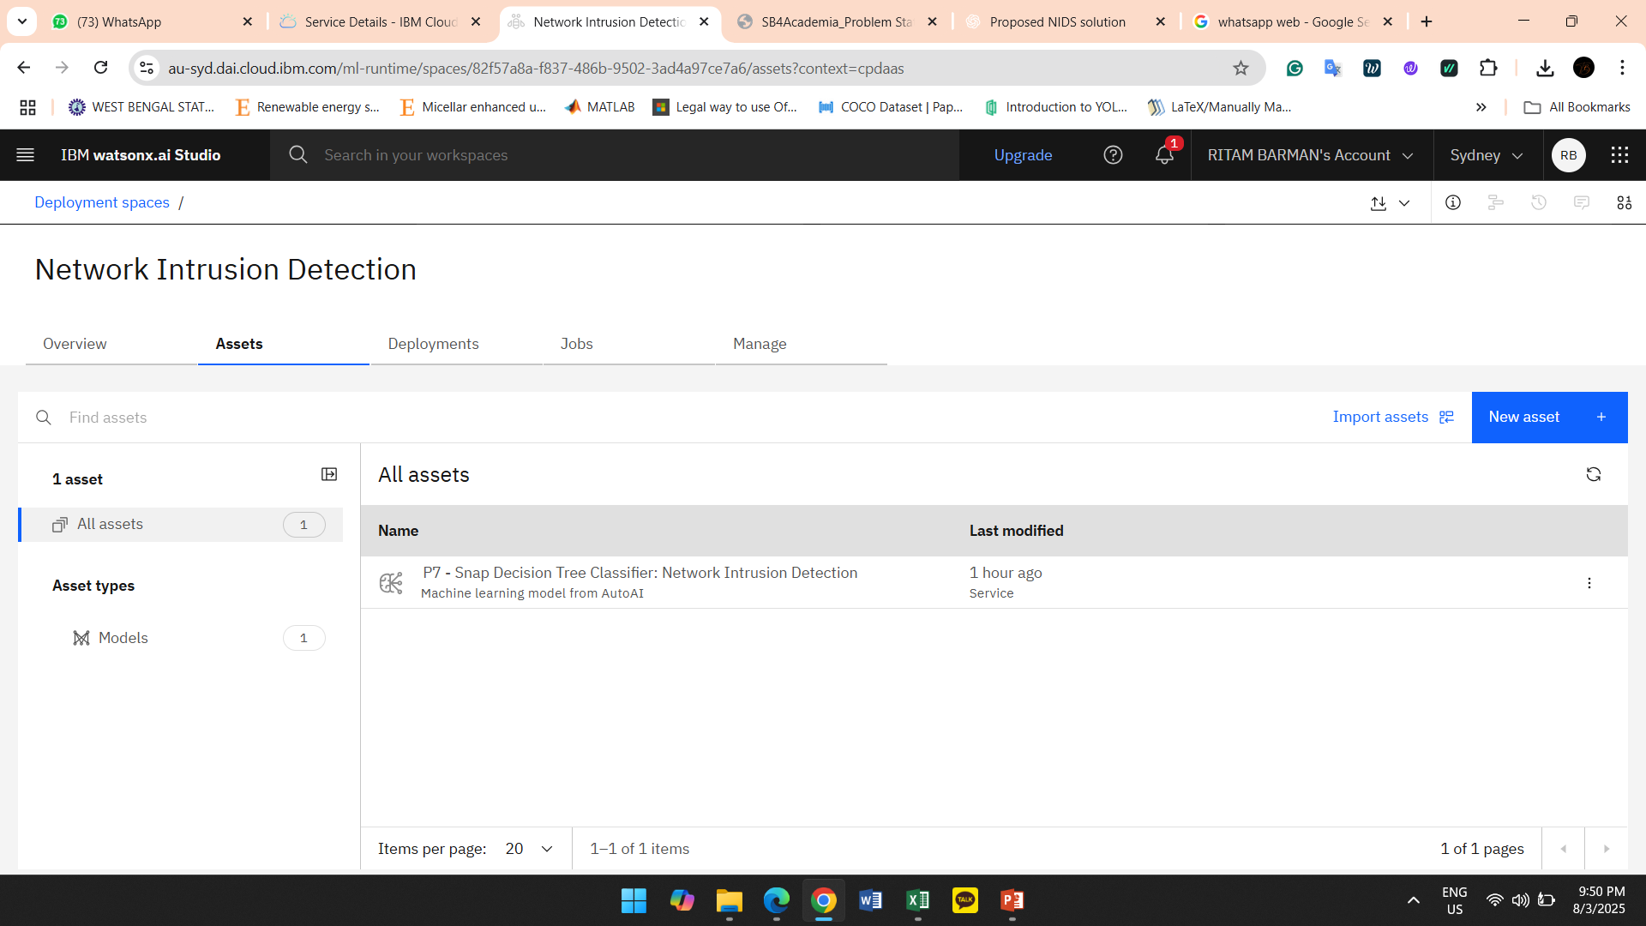
Result

Slide 8
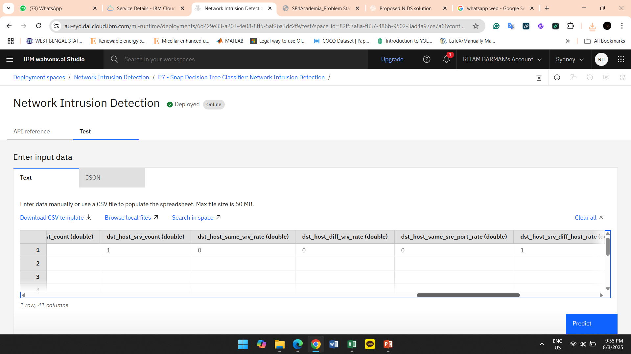
Result

Slide 9
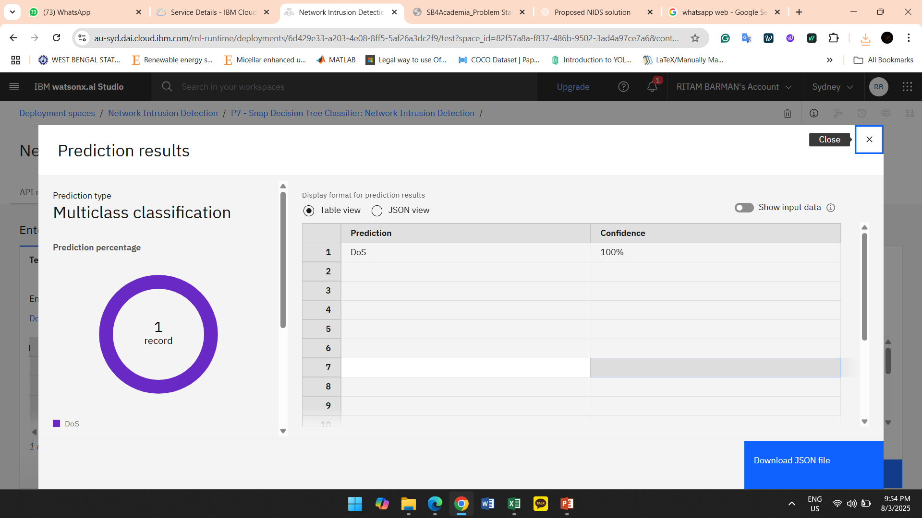
Result

Slide 10
Conclusion
In this project, we successfully developed a machine learning-based Network Intrusion Detection System (NIDS) using the KDD Cup '99 dataset from Kaggle. The system was designed to:
Preprocess and analyze network traffic data
Classify traffic into normal and multiple types of attacks (DoS, Probe, R2L, U2R)
Deploy the trained model on IBM Cloud Lite using Watson Studio and Watson Machine Learning
Through rigorous training and evaluation, our system achieved high classification accuracy, demonstrating its potential as a practical tool for real-time intrusion detection in communication networks. By leveraging IBM Cloud services, we ensured scalability, accessibility, and cloud-based deployment capabilities, allowing for easier integration into production environments.
The results indicate that machine learning can significantly enhance the detection of cyber threats and reduce false positives compared to traditional signature-based systems.

Slide 11
Future scope
To improve and extend the capabilities of the system, several future directions can be explored:
🔄 1. Continuous Learning and Adaptive Models
Implement online or incremental learning algorithms to adapt to evolving threats.
Enable automatic model retraining with newly collected data from live networks.
📡 2. Real-Time Traffic Monitoring
Integrate real-time network traffic capture using packet sniffers (e.g., Wireshark, Scapy).
Use IBM Cloud Functions or streaming platforms (e.g., Apache Kafka on IBM Cloud) to process live data.

Slide 12
References
IBM Watsonx Documentation
GeeksforGeeks, InterviewBit
indeed, Zety (soft skills Q&A)
IBM RAG Lab & Model Guide
Sample Q&A sheet
IBM Certificates

Slide 13
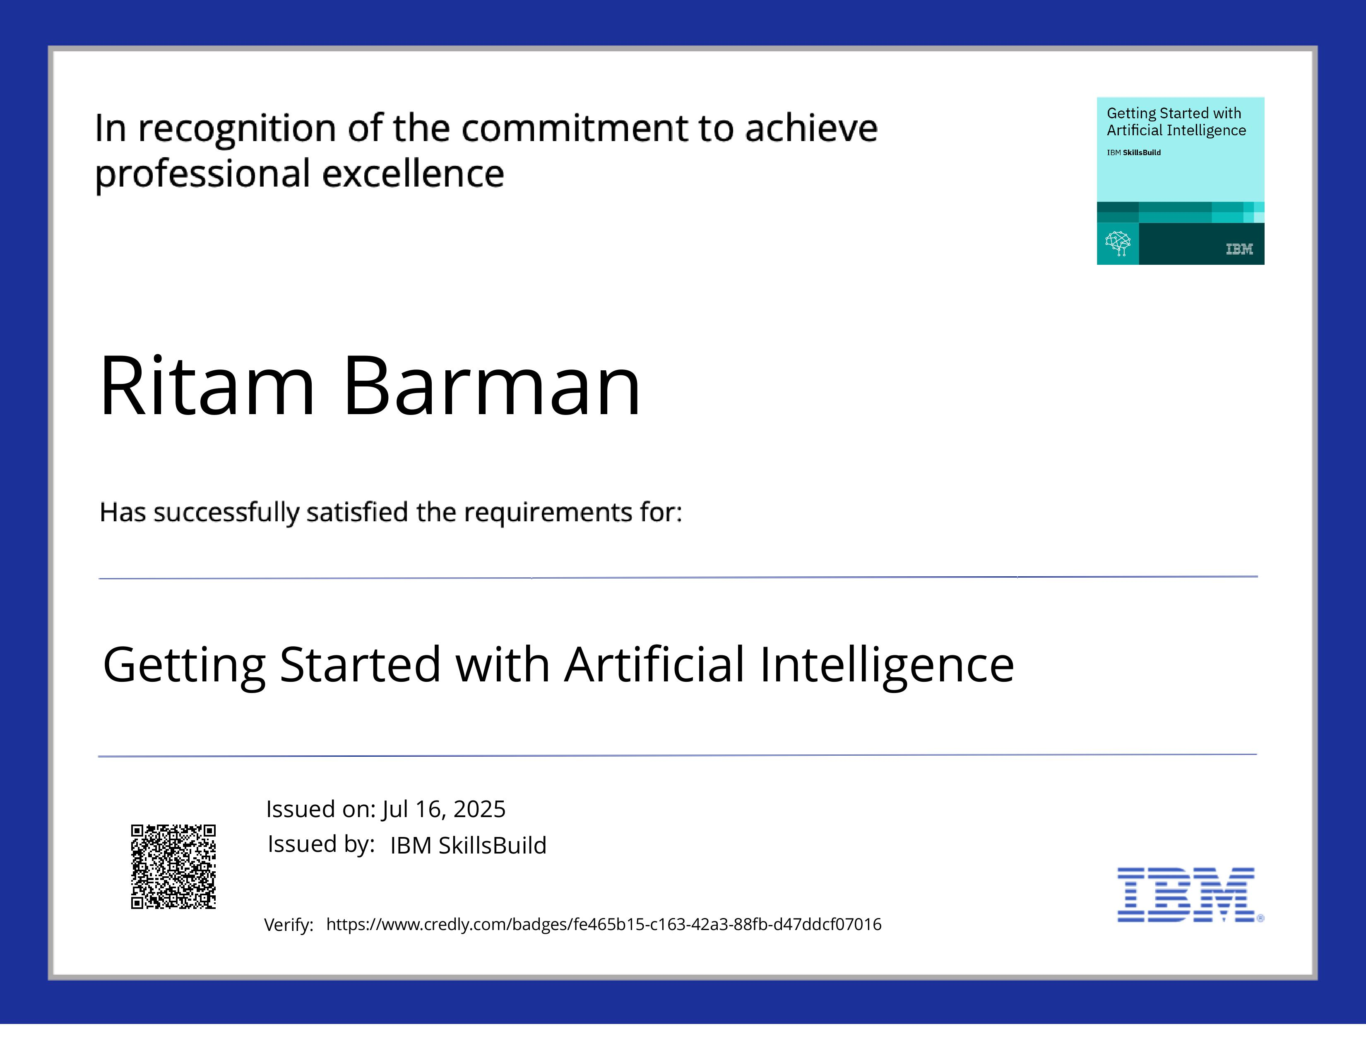
IBM Certifications
Screenshot/ credly certificate( getting started with AI)

Slide 14
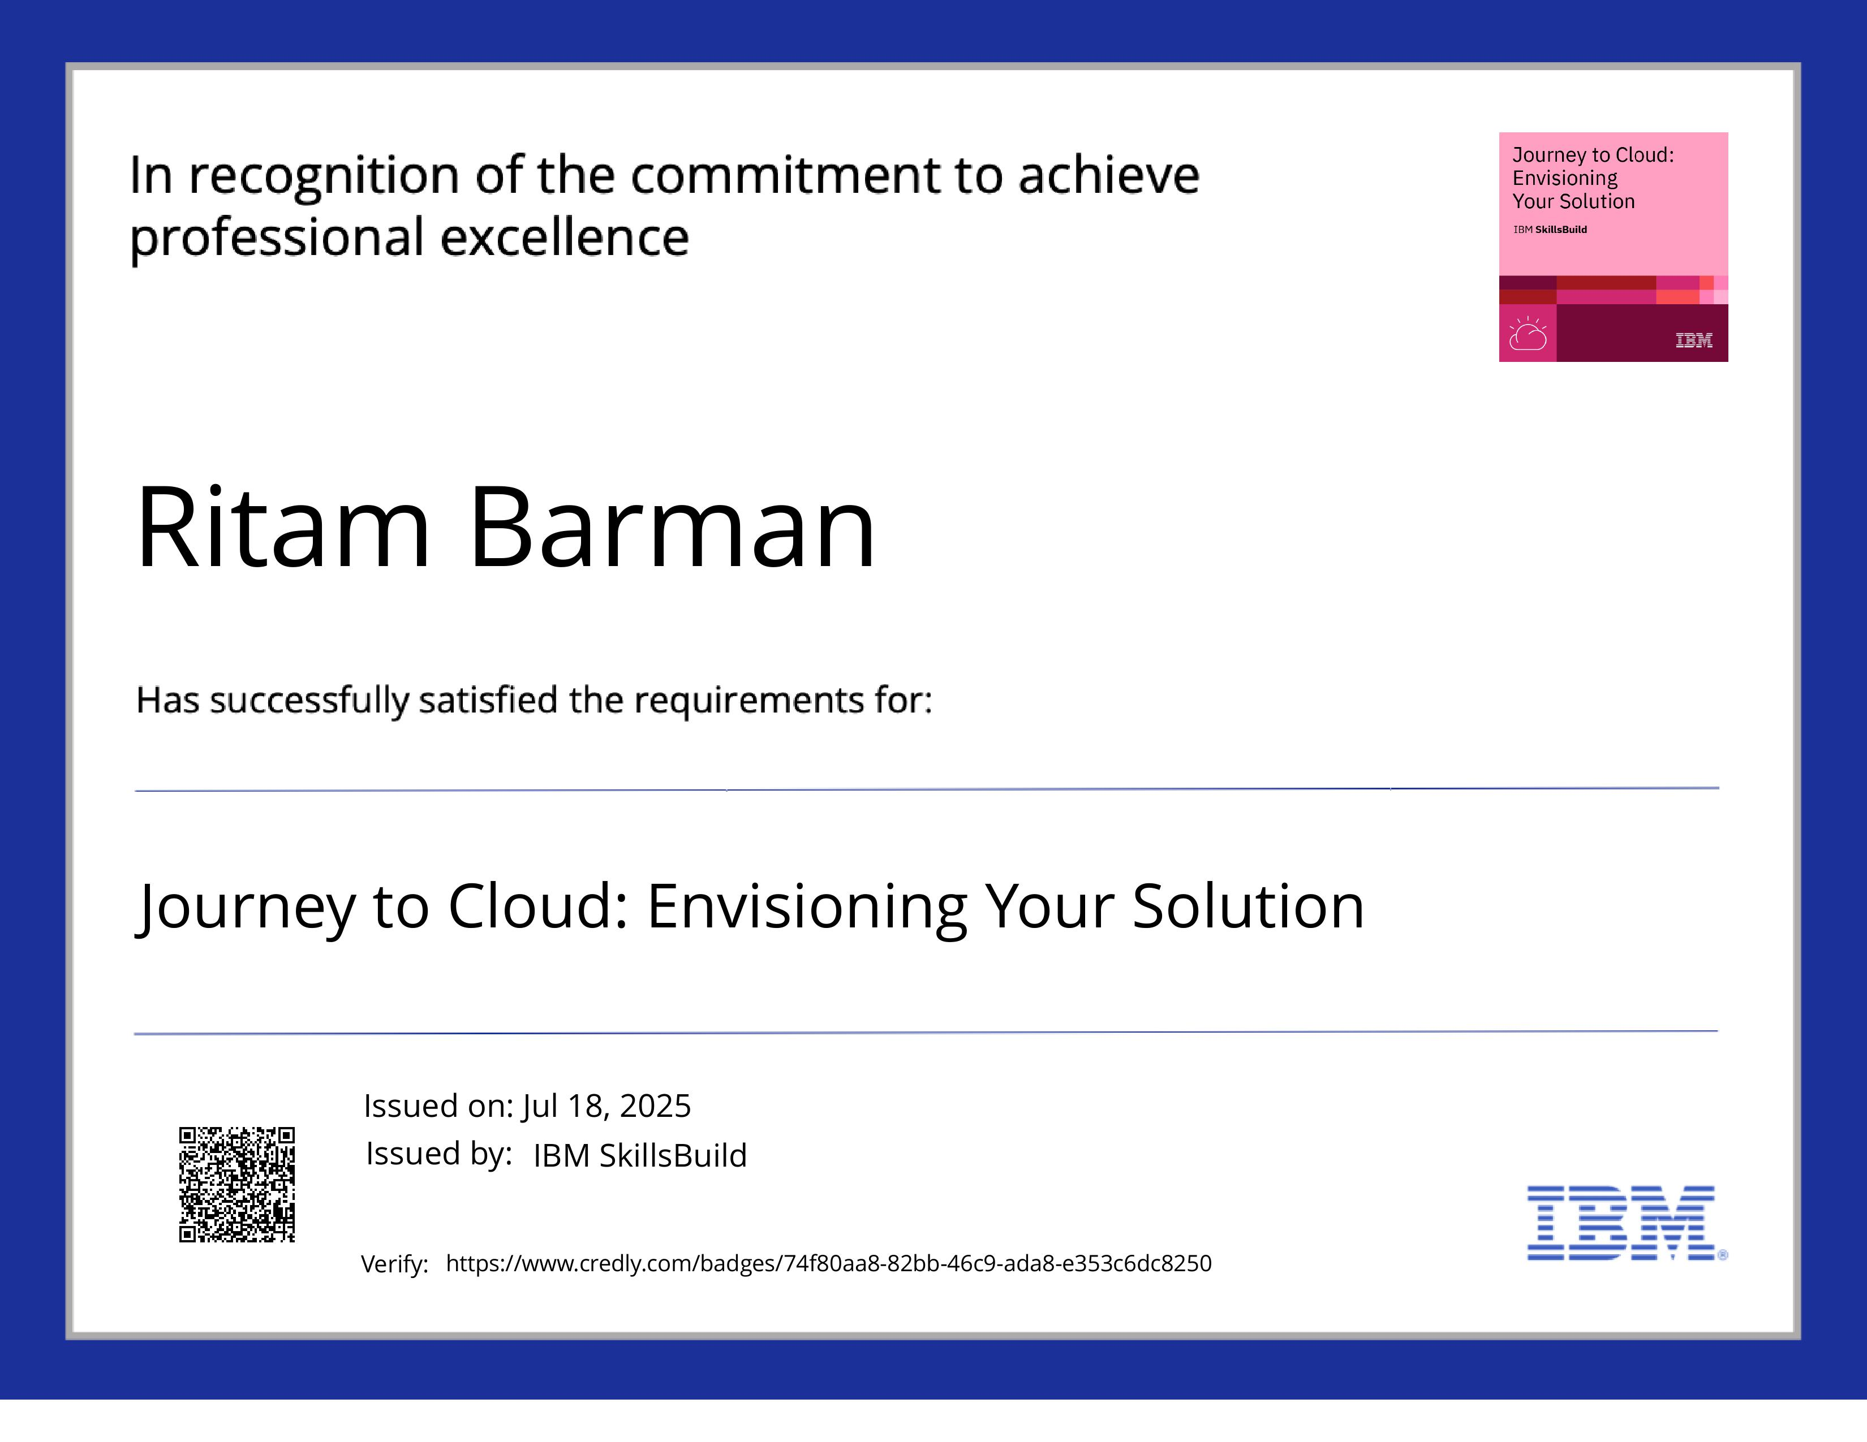
IBM Certifications
Screenshot/ credly certificate( Journey to Cloud)

Slide 15
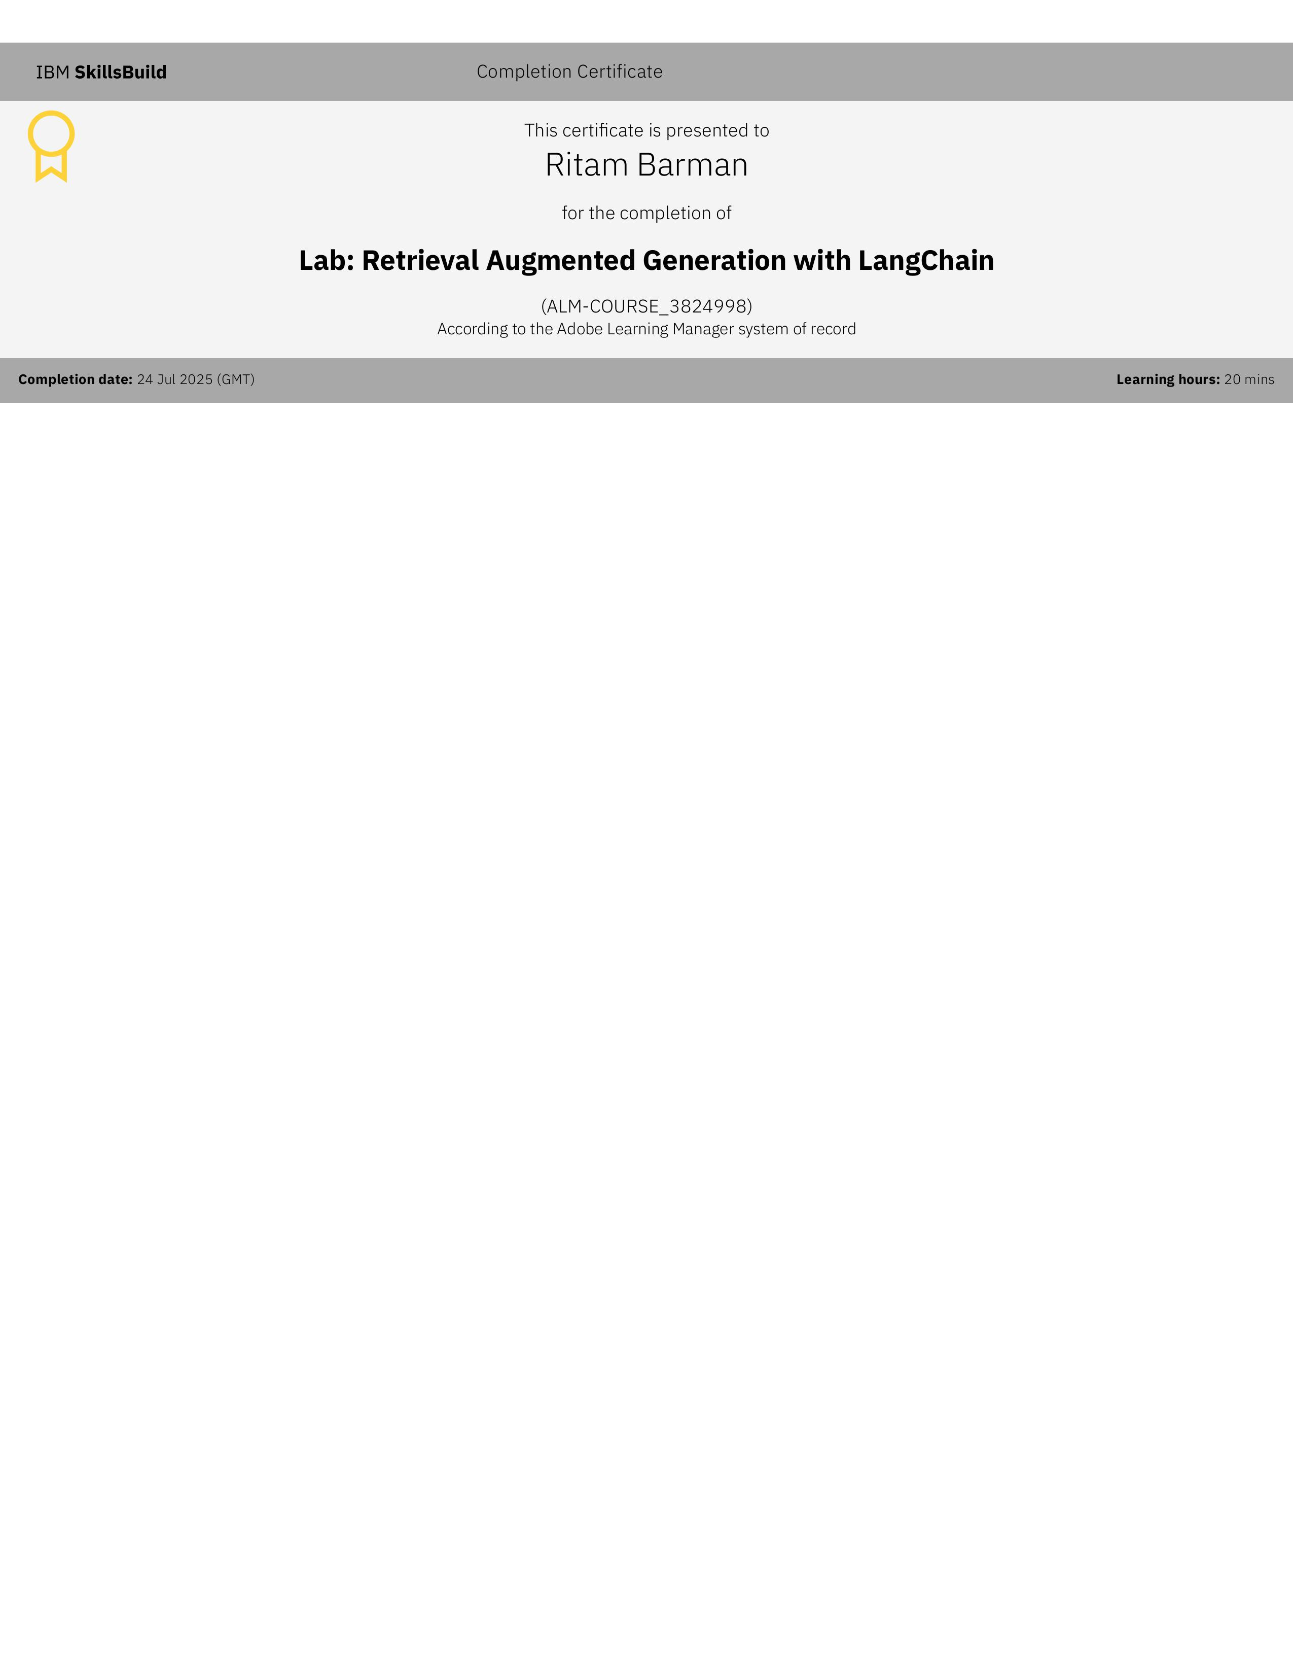
IBM Certifications
Screenshot/ credly certificate( RAG Lab)

Slide 16
THANK YOU

